Slide 1

Project Proposal
Name: Charlie Medialdea
Course: CSIS 4495 - 001

Slide 2
Option 1) NBA Lakers – Improving Team Roster using Machine Learning
Predicting which free agents will perform well with the team within a specific budget.
Predicting which player is open for trades that can improve the team roster while adhering to the salary cap.
Goal:
Enhancing of the Lakers Roster by:
Retaining core players.
Adding cost-effective players
Avoiding excessive luxury taxes.

Slide 3
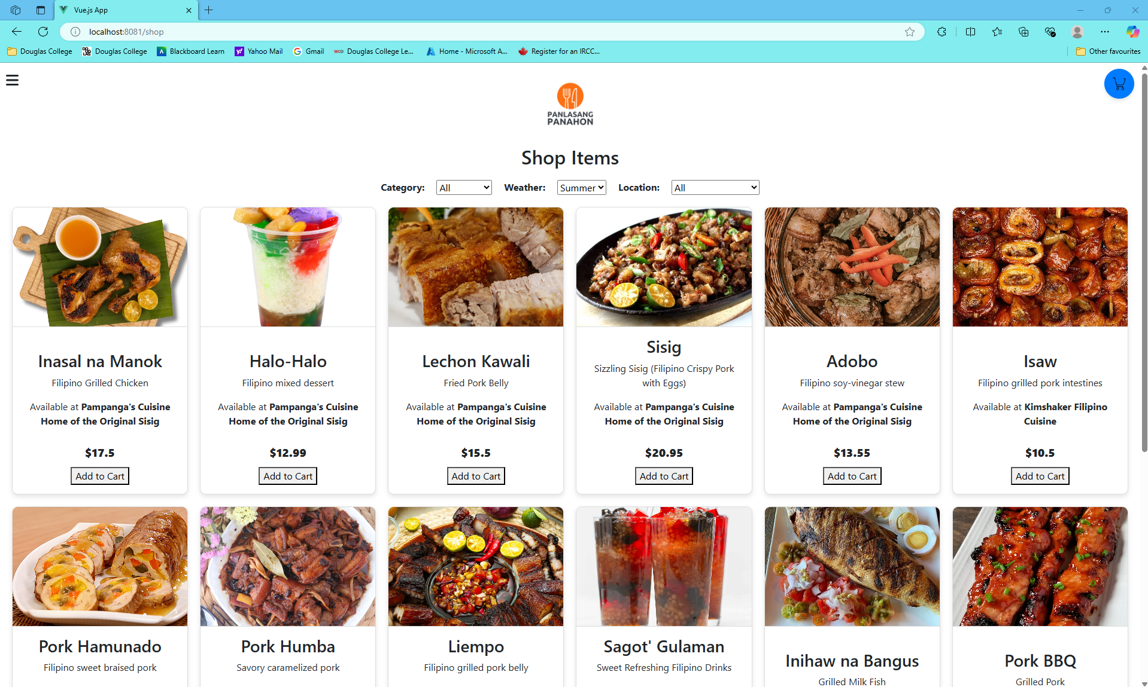
Option 2) Panlasang Panahon - English translation is Filipino taste) and "panahon" (English translation is weather), emphasizing how the menu is tailored to the weather.
The project allows users to order food based on the current weather. The project provides a personalized food browsing experience that adjusts its recommendations based on the weather conditions, such as offering warm comfort food on a rainy day or ice cream cravings on a hot sunny day.

Slide 4
Option 3) Pasa-buy CA to PH
Is a service that connects users from Canada to the Philippines.
Users can browse this web application for products available in Canada (e.g., clothes, bags, shoes, and food).
Users will be allowed to post a request if the item is not on the list.
Users can view the shipping policy.
Payment will be all local to the Philippines.

Slide 5
Option 4) Joining the vetted project
Spread Goodness project.

